Slide 1


Kishen Chandar M
28 June 2023

Slide 2

Outline
Executive Summary
Introduction
Methodology
Results
Conclusion

Slide 3
Executive Summary
Summary of methodologies
Data Collection through API
Data Collection with Web Scraping
Data Wrangling
Exploratory Data Analysis with SQL
Exploratory Data Analysis with Data Visualization
Interactive Visual Analytics with Folium
Machine Learning Prediction
Summary of all results
Insightful and relevant data was collected using public sources. Exploratory Data Analysis resulted in identifying the best features to predict the success of launches. ML prediction allowed to identify the best model to predict the characteristics that are important for the launch.

Slide 4
Introduction
Project background and context
Space X advertises Falcon 9 rocket launches on its website with a cost of 62 million dollars; other providers cost upward of 165 million dollars each, much of the savings is because Space X can reuse the first stage.
If it can be determined that the first stage is a success - i.e., the rocket can land, we can determine the cost of a launch. This information can be used if an alternate company wants to bid against space X for a rocket launch.
The objective is to evaluate the feasibility of the new company Space Y to compete with Space X
Problems you want to find answers
What are the factors that determine the rocket will land successfully?
The correlation amongst various features that determine the success rate of a successful landing.
Pre-conditions that needs to be in place to ensure a successful landing program

Slide 5

Section 1

Slide 6
Methodology
Executive Summary
Data collection methodology:
Collected using API and web-scraping various web sources
Perform data wrangling
One-hot encoding on categorical features in applied
Perform exploratory data analysis (EDA) using visualization and SQL
Perform interactive visual analytics using Folium and Plotly Dash
Perform predictive analysis using classification models
How to build, tune, evaluate classification models

Slide 7
Data Collection
Data was primarily collected from the following sources:
Space X API (https://api.spacexdata.com/v4/rockets/)
From Wikipedia using web scraping (https://en.wikipedia.org/wiki/List_of_Falcon/_9/_and_Falcon_Heavy_launches)

Slide 8
Data Collection – SpaceX API
Data sourced using SpaceX public API. The adjacent flowchart explains the summary of process
GitHub URL:
https://github.com/kishenchandar/MyFirstRepository/blob/main/jupyter-labs-spacex-data-collection-api.ipynb
SpaceX API Request and parse the data
Include data of only Falcon 9 using filtering
Missing values are appropriately addressed

Slide 9
Data Collection - Scraping
Web scrap Falcon 9 launch records with BeautifulSoup:
Extract a Falcon 9 launch records HTML table from Wikipedia
Parse the table and convert it into a Pandas data frame
GitHub URL
https://github.com/kishenchandar/MyFirstRepository/blob/main/jupyter-labs-webscraping.ipynb
Request the Falcon9 Launch Wiki page from its URL using BeautifulSoup
Extract all column/variable names from the HTML table header
Create a data frame by parsing the launch HTML tables
Export it as a CSV file

Slide 10
Data Wrangling
Perform exploratory Data Analysis and determine Training Labels
Exploratory Data Analysis
Determine Training Labels
GitHub URL: https://github.com/kishenchandar/MyFirstRepository/blob/main/IBM-DS0321EN-SkillsNetwork_labs_module_1_L3_labs-jupyter-spacex-data_wrangling_jupyterlite.jupyterlite.ipynb
Calculate the number of launches on each site
Calculate the number and occurrence of each orbit
Calculate the number and occurrence of mission outcome per orbit type
Create a landing outcome label from Outcome column
Export data as CSV

Slide 11
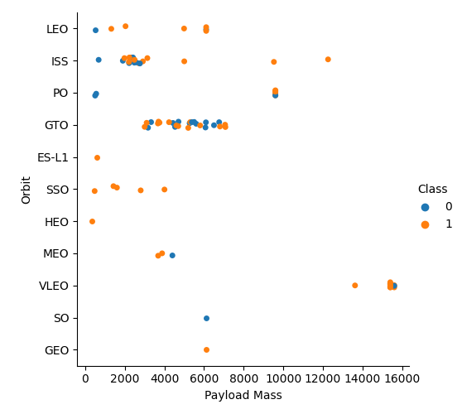
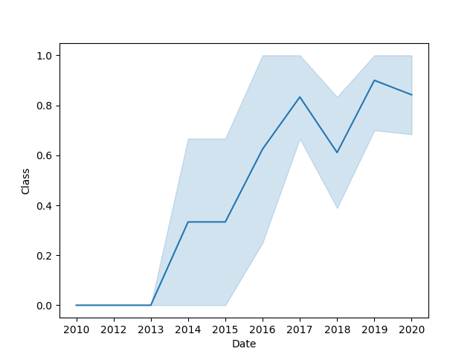
EDA with Data Visualization
Exploratory data analysis is done mainly using scatter plots, bar plots and line charts to visualize the relationships between several features. The following charts were plotted:
Payload Mass vs Flight Number
Launch Site vs Flight Number
Launch Site vs Payload Mass
Success rate of each orbit vs Orbit
Orbit vs Flight number
Orbit vs Payload Mass
Class vs Date (line chart)
GitHub: https://github.com/kishenchandar/MyFirstRepository/blob/main/IBM-DS0321EN-SkillsNetwork_labs_module_2_jupyter-labs-eda-dataviz.ipynb.jupyterlite%20(1).ipynb

Slide 12
EDA with SQL
Summary of SQL queries for EDA
Display the names of the unique launch sites in the space mission
Display 5 records where launch sites begin with the string 'CCA'
Display the total payload mass carried by boosters launched by NASA (CRS)
Display average payload mass carried by booster version F9 v1.1
List the date when the first successful landing outcome in ground pad was achieved.
List the names of the boosters which have success in drone ship and have payload mass greater than 4000 but less than 6000
List the total number of successful and failure mission outcomes
List the names of the booster_versions which have carried the maximum payload mass.
List the records which will display the month names, failure landing_outcomes in drone ship, booster versions, launch site for the months in year 2015.
Rank the count of successful landing_outcomes between the date 04-06-2010 and 20-03-2017 in descending order.
GitHub URL: https://github.com/kishenchandar/MyFirstRepository/blob/main/jupyter-labs-eda-sql-coursera_sqllite.ipynb

Slide 13
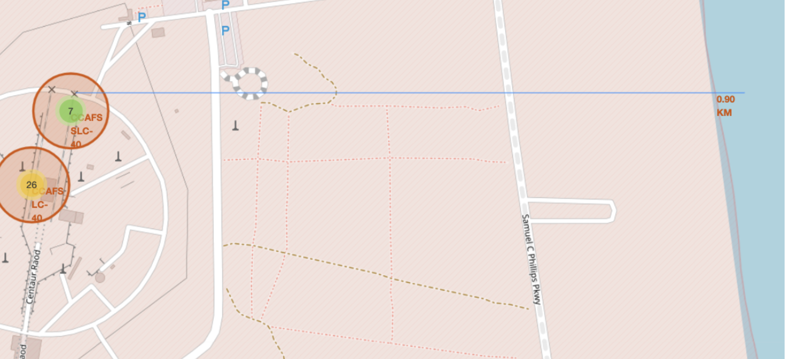
Build an Interactive Map with Folium
Summary
Marked all launch sites on a map:
Added each site's location on a map using site's latitude and longitude coordinates
Used folium Circles to add a highlighted circle area with a text label on a specific coordinate.
Created markers for all launch records
Marked the success/failed launches for each site on the map
Calculated the distances between a launch site to its proximities
Drew a Line between a launch site to the selected coastline point
Found some geographical patterns about launch sites.
GitHub URL: https://github.com/kishenchandar/MyFirstRepository/blob/main/IBM-DS0321EN-SkillsNetwork_labs_module_3_lab_jupyter_launch_site_location.jupyterlite.ipynb

Slide 14
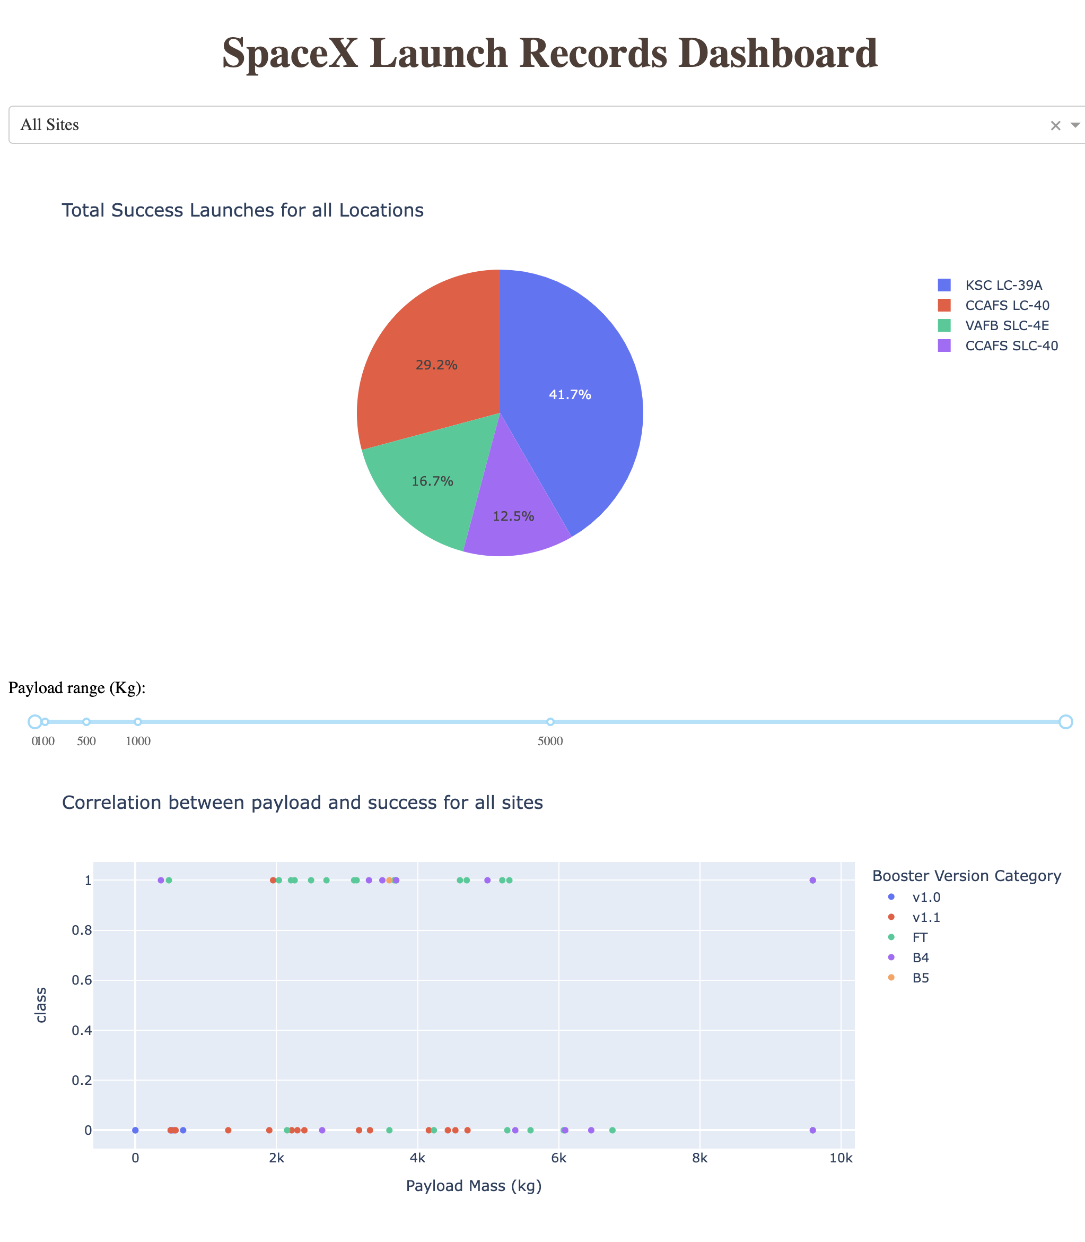
Build a Dashboard with Plotly Dash
A pie plot and a scatter plot are used to visualize the success rate of all launch sites and the correlation between payload and success rate for all sites
A payload range slider and a dropdown menu to select the launch site are added to the dashboard.
These interactions were used to quickly analyze the relation between payloads and launch sites. Further, to help identify where is best place to launch according to payload sizes.
https://github.com/kishenchandar/MyFirstRepository/blob/main/spacex_dash.png

Slide 15
Predictive Analysis (Classification)
Four classification models were compared: logistic regression, support vector machine, decision tree and k nearest neighbors.
https://github.com/kishenchandar/MyFirstRepository/blob/main/IBM-DS0321EN-SkillsNetwork_labs_module_4_SpaceX_Machine_Learning_Prediction_Part_5.jupyterlite.ipynb
Data Preparation and Standardisation
Test of each model with combinations of hyper parameters
Comparison of results

Slide 16
Results
Exploratory data analysis results
Space X uses 4 different launch sites;
The first launches were done to Space X itself and NASA;
The average payload of F9 v1.1 booster is 2,928 kg;
The first success landing outcome happened in 2015 fiver year after the first launch;
Many Falcon 9 booster versions were successful at landing in drone ships having payload above the average;
Almost 100% of mission outcomes were successful;
Two booster versions failed at landing in drone ships in 2015: F9 v1.1 B1012 and F9 v1.1 B1015;
The number of landing outcomes became as better as years passed.

Slide 17
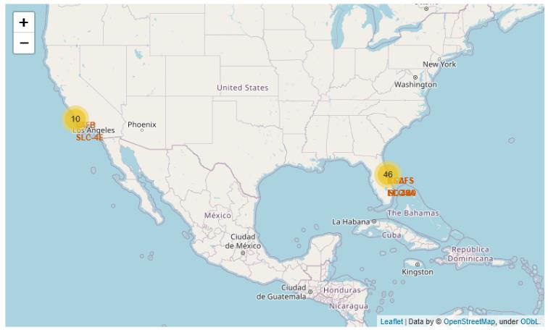
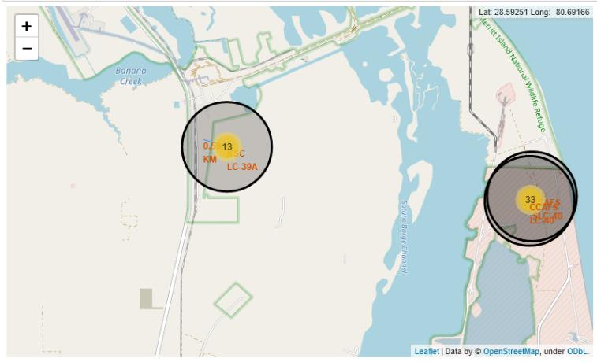
Results
Interactive analytics demo in screenshots
Using interactive analytics was possible to identify that launch sites use to be in safety places, near sea, for example and have a good logistic infrastructure around.
Most launches happens at east coast launch sites.

Slide 18
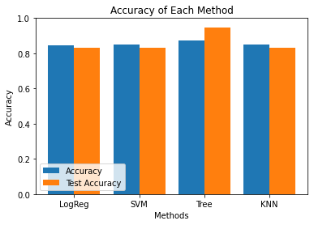
Results
Predictive analysis results
Predictive Analysis showed that Decision Tree Classifier is the best model to predict successful landings, having accuracy over 87% and accuracy for test data over 94%.

Slide 19

Section 2

Slide 20
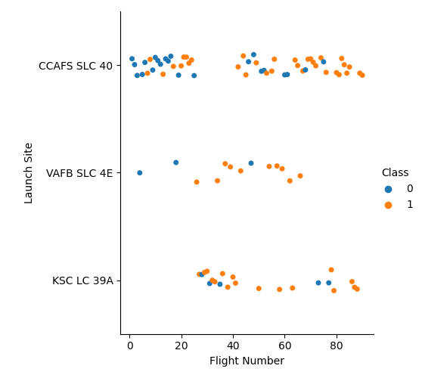
Flight Number vs. Launch Site
We can observe that VAFB SLC 4E and KSC LC 39A had better success rates
Also, the success rates improved over time across all locations.

Slide 21
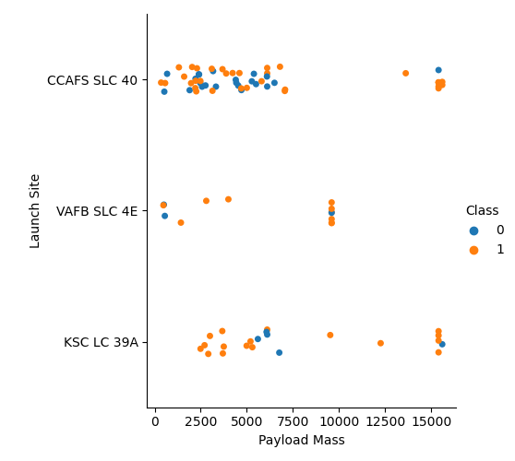
Payload vs. Launch Site
For the VAFB-SLC launch site there are no rockets launched for heavy payload mass(greater than 10000)
Higher the payload mass greater is the success rate
For location KSC LC 39A, smaller payloads have greater success

Slide 22
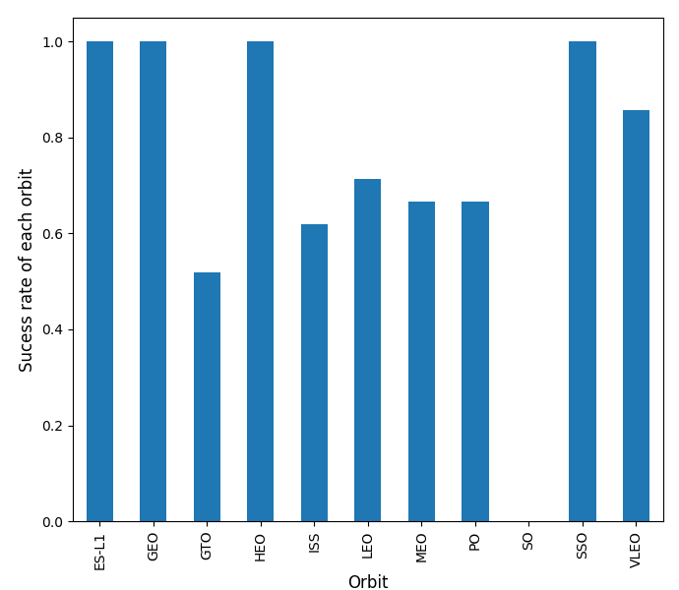
Success Rate vs. Orbit Type
As per the chart, the following orbits have the highest success rate:
ES-L1
GEO
HEO
SSO
VLEO

Slide 23
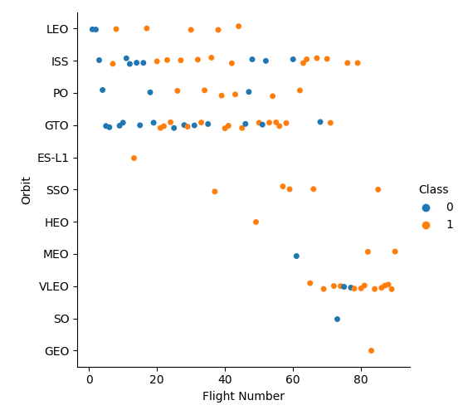
Flight Number vs. Orbit Type
In the LEO orbit the Success appears related to the number of flights; on the other hand, there seems to be no relationship between flight number when in GTO orbit.

Slide 24
Payload vs. Orbit Type
With heavy payloads the successful landing or positive landing rate are more for Polar,LEO and ISS.
However for GTO we cannot distinguish this well as both positive landing rate and negative landing (unsuccessful mission) are both there here.

Slide 25
Launch Success Yearly Trend
One can observe that success rate since 2013 kept increasing

Slide 26
All Launch Site Names
Names of the unique launch sites
CCAFS LC-40
CCAFS SLC-40
KSC LC-39A
VAFB SLC-4E
We used the key word DISTINCT to show only unique launch sites from the SpaceX data.

Slide 27
Launch Site Names Begin with 'CCA'
Find 5 records where launch sites begin with `CCA`
Date | Time UTC | Booster Version | Launch Site | Payload | Payload Mass kg | Orbit | Customer | Mission Outcome | Landing Outcome
2010-06-04 | 18:45:00 | F9 v1.0 B0003 | CCAFS LC-40 | Dragon Spacecraft Qualification Unit | 0 | LEO | SpaceX | Success | Failure (parachute)
2010-12-08 | 15:43:00 | F9 v1.0 B0004 | CCAFS LC-40 | Dragon demo flight C1, two CubeSats, barrel of Brouere cheese | 0 | LEO (ISS) | NASA (COTS) NRO | Success | Failure (parachute)
2012-05-22 | 07:44:00 | F9 v1.0 B0005 | CCAFS LC-40 | Dragon demo flight C2 | 525 | LEO (ISS) | NASA (COTS) | Success | No attempt
2012-10-08 | 00:35:00 | F9 v1.0 B0006 | CCAFS LC-40 | SpaceX CRS-1 | 500 | LEO (ISS) | NASA (CRS) | Success | No attempt
2013-03-01 | 15:10:00 | F9 v1.0 B0007 | CCAFS LC-40 | SpaceX CRS-2 | 677 | LEO (ISS) | NASA (CRS) | Success | No attempt

Slide 28
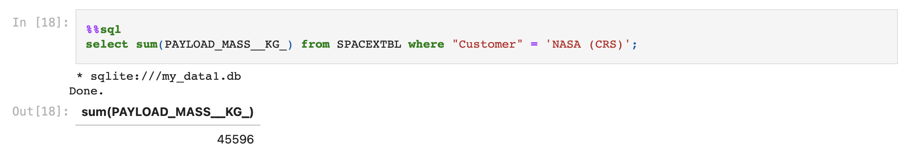
Total Payload Mass
Calculate the total payload carried by boosters from NASA

Slide 29
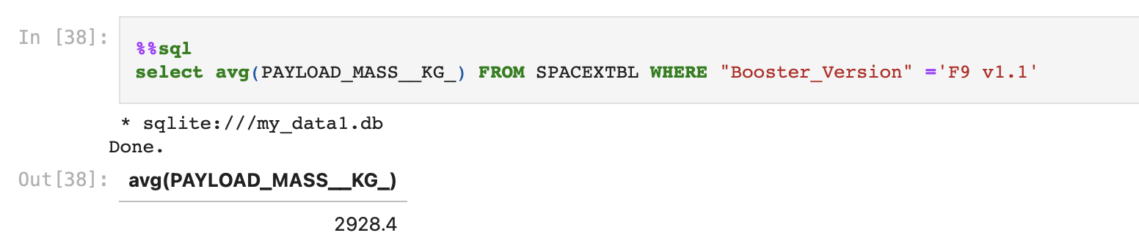
Average Payload Mass by F9 v1.1
Calculate the average payload mass carried by booster version F9 v1.1

Slide 30
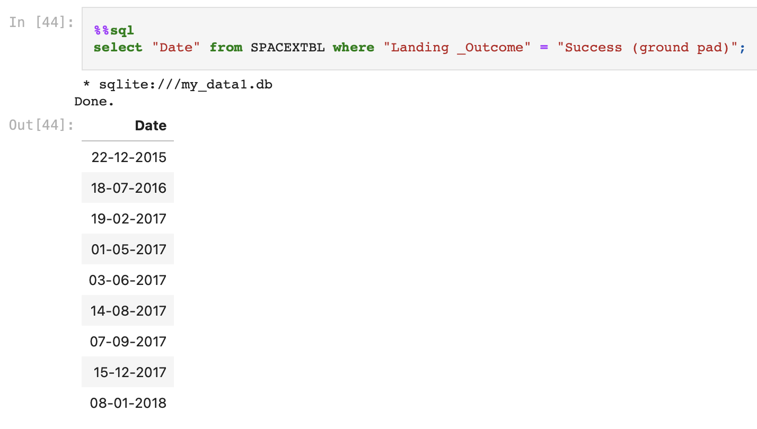
First Successful Ground Landing Date
Find the dates of the first successful landing outcome on ground pad

Slide 31
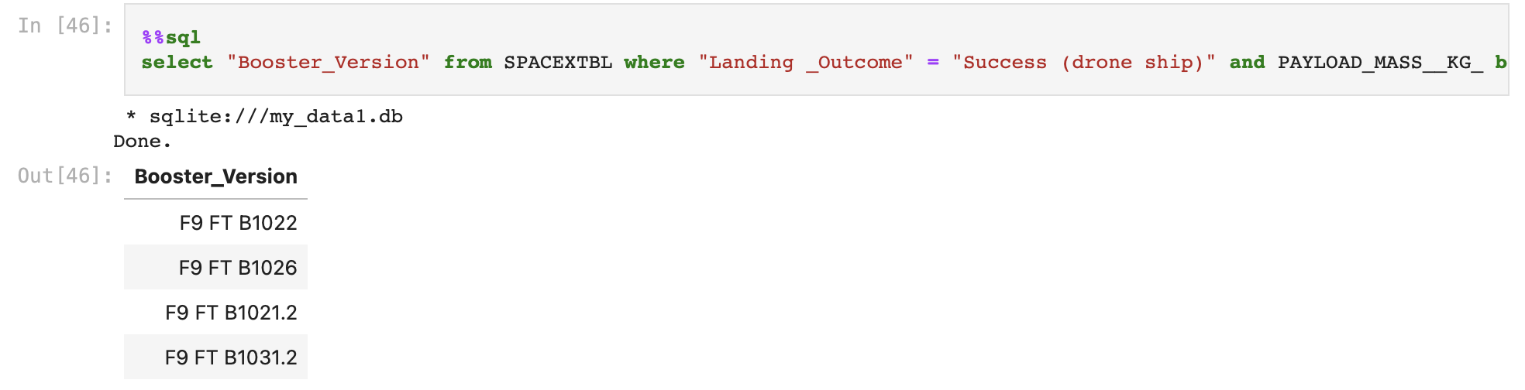
Successful Drone Ship Landing with Payload between 4000 and 6000
List the names of boosters which have successfully landed on drone ship and had payload mass greater than 4000 but less than 6000

Slide 32
Total Number of Successful and Failure Mission Outcomes
Calculate the total number of successful and failure mission outcome
Successful: 100
Failed: 1

Slide 33
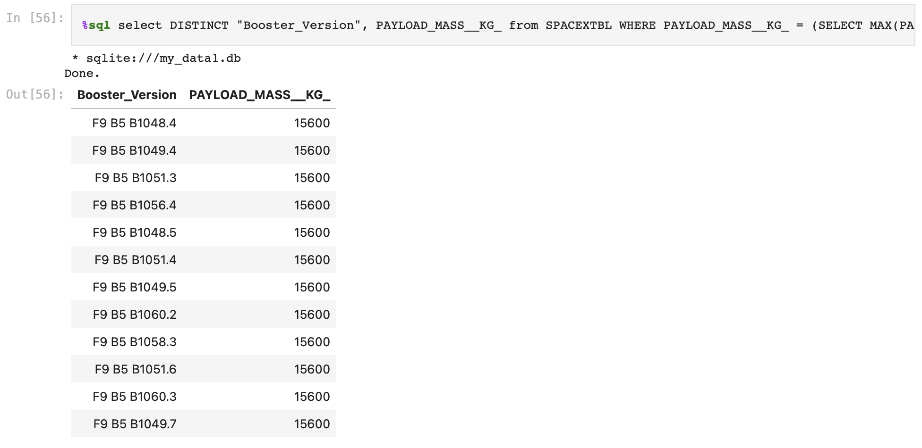
Boosters Carried Maximum Payload
List the names of the booster which have carried the maximum payload mass

Slide 34
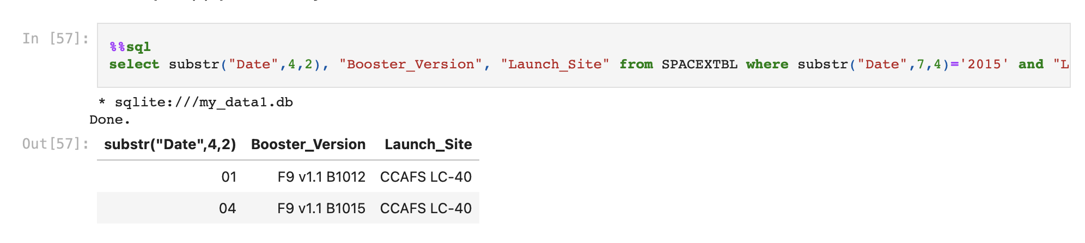
2015 Launch Records
List the failed landing_outcomes in drone ship, their booster versions, and launch site names for in year 2015

Slide 35
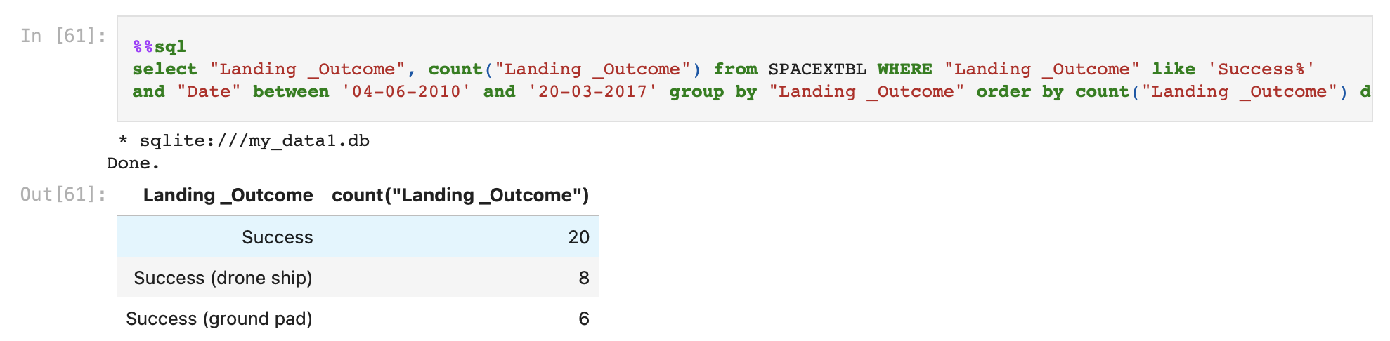
Rank Landing Outcomes Between 2010-06-04 and 2017-03-20
Rank the count of landing outcomes (such as Failure (drone ship) or Success (ground pad)) between the date 2010-06-04 and 2017-03-20, in descending order

Slide 36

Section 3

Slide 37

All Launch Sites
All launch sites are near the sea.
All launch sites are at the southern most parts of the USA

Slide 38
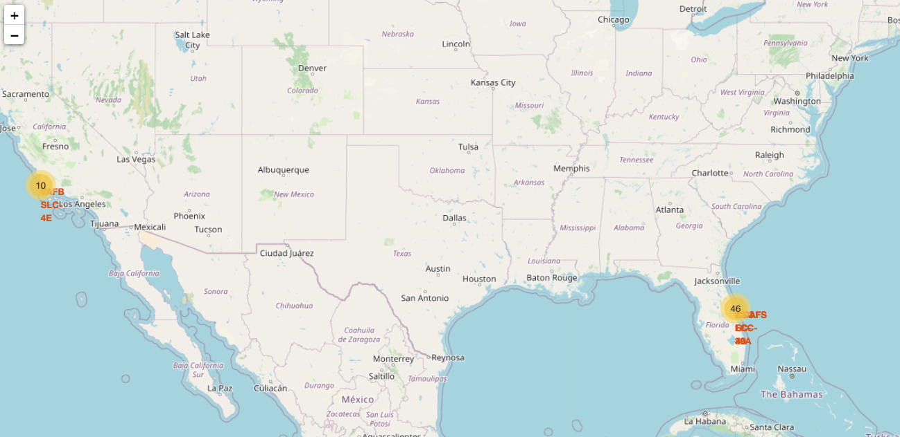

Success/Failed launches for each site
Green markers indicate successful and red ones indicate failure.

Slide 39

Distance between launch sites to its proximities
All launch sites are closest to the sea
Not all launch site are close to Railways
Launch site KSC LC-39A isnear railroad and road and relatively far from inhabited areas.

Slide 40

Section 4

Slide 41
Success rates of each launch site
KSC LC-39A has the highest percentage of successful launches followed by CCAFS LC-40

Slide 42
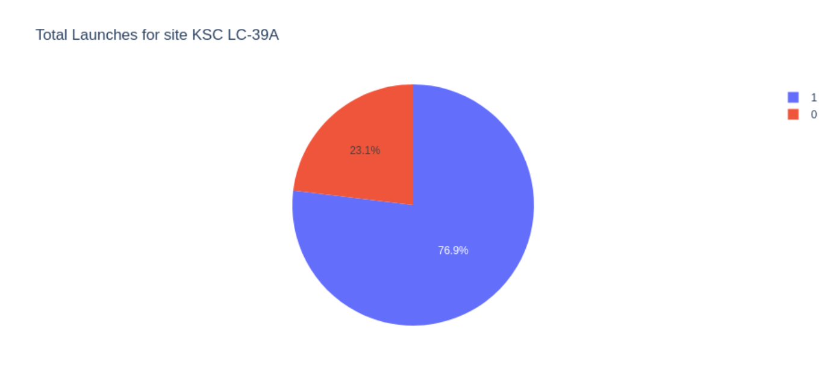
Highest launch success ratio
KSC LC-39A has the highest launch success ratio with 76.9% success rate.

Slide 43
Payload vs. Launch Outcome
Payloads under 6,000kg and FT boosters are the most successful combination.

Slide 44

Section 5

Slide 45
Classification Accuracy
Decision tree classifier has the highest classification accuracy

Slide 46
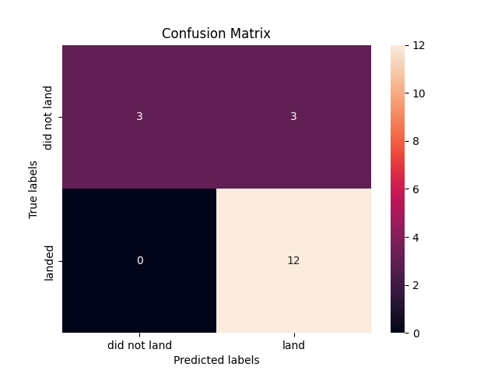
Confusion Matrix
The confusion matrix for the decision tree classifier shows that the classifier can distinguish between the different classes. The major problem is the false positives.

Slide 47
Conclusions
The larger the flight amount at a launch site, the greater the success rate at a launch site.
Launch success rate started to increase in 2013 till 2020.
Although most of mission outcomes are successful, successful landing outcomes seem to improve over time
Orbits ES-L1, GEO, HEO, SSO, VLEO had the most success rate.
KSC LC-39A had the most successful launches of any sites.
The Decision tree classifier is the best machine learning algorithm for this task. It can be used to predict successful landings and increase profits.

Slide 48


